Slide 1
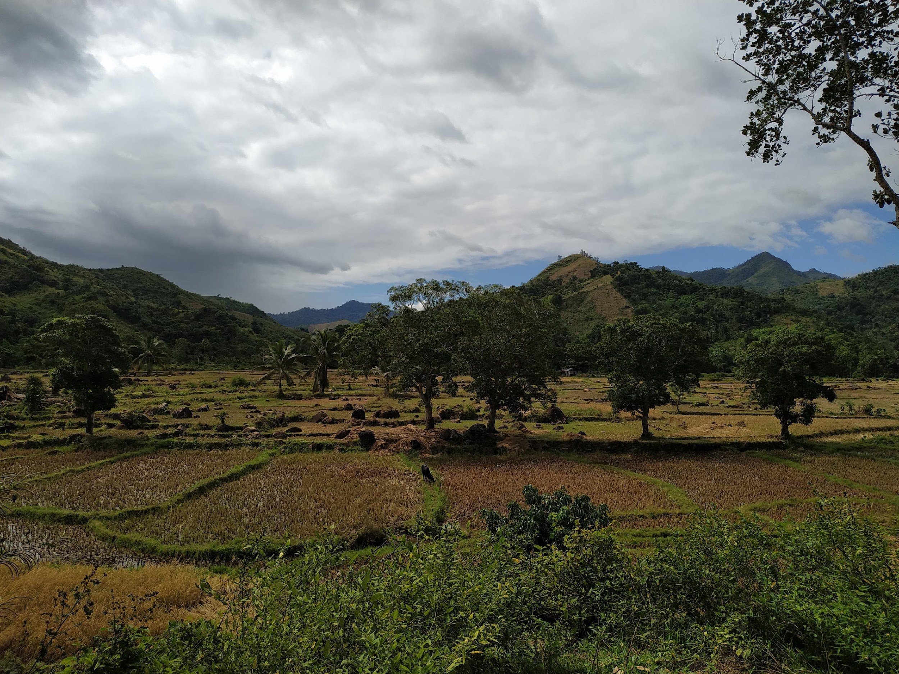
Land use and microbe prevalence jointly determine host-microbe network structure
Matan Markfeld, Georgia Titcomb, Charles Nunn, Shai Pilosof
May 15, 2024

Slide 2
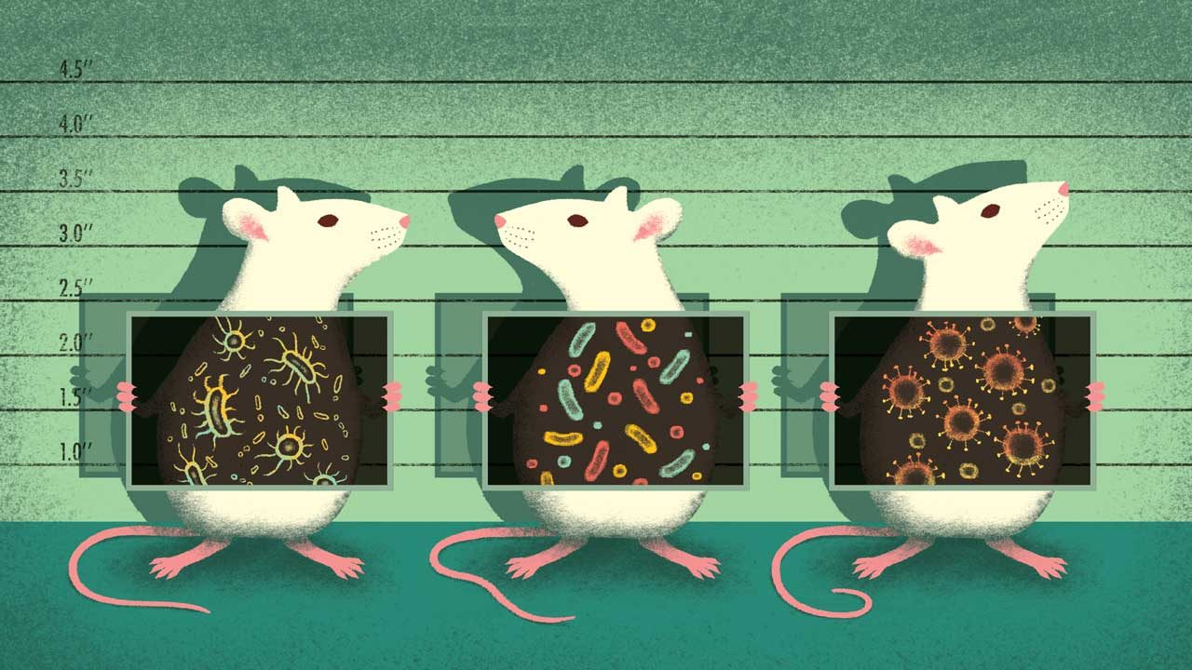
The microbiome is crucial for host health and function
It is important to understand the processes and factors that shape the microbiome
Berg et. al., 2020; Rosenberg & Zilber-Rosenberg, 2018
Notes:
the microbiome is crucial for the host health and function. Changes to the microbiome might change the host’s function and make it more susceptible to disease, for example.
Affecting disease.. specifically in rodents that are an important reservoir of zoonotic disease agents.
Therefore, it is important to understand the processes and factors that shape the microbiome.

Slide 3
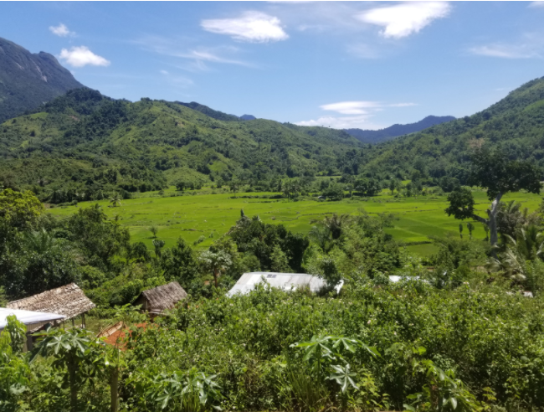
Land use change
Forest
Agriculture
Village
Host Microbiome
Newbold et. al., 2015; Bernardo-Carvo et. al., 2020; Fackelmann et. al., 2021
Notes:
Anthropogenic land use change, including the conversion of natural areas to agricultural or urban ecosystems, alters the environment and the conditions in which the host microbiome is shaped.

Slide 4
Land use change
Forest
Agriculture
Host community change
Village
Host Microbiome
Newbold et. al., 2015; Bernardo-Carvo et. al., 2020; Fackelmann et. al., 2021
Notes:
land use change can alter the host microbiome in different ways. It changes the host community composition and abundance, which can affect the transmission of microbes between hosts.

Slide 5
Land use change
Forest
Agriculture
Host community change
Human-Wildlife interface
Village
Diet shift
Host Microbiome
Newbold et. al., 2015; Bernardo-Carvo et. al., 2020; Fackelmann et. al., 2021
Notes:
Additionally, Human-wildlife interface is changed with agricultural practices. This can lead to diet shift of the host and to changes in the gut conditions.
and of course, that also can expose animals to human microbes and pathogens.

Slide 6
Selective processes
Land use change
Forest
Agriculture
Host community change
Human-Wildlife interface
Village
Diet shift
Neutral processes
Host Microbiome
Newbold et. al., 2015; Bernardo-Carvo et. al., 2020; Fackelmann et. al., 2021

Slide 7

While most microbiome research focuses on humans or domestic animals, we still don’t know a lot about wild animals and how environmental factors, such as land use change, affect their microbiome
Assessing the effect of land use change on the microbial community is challenging, as the landscape is continuous and not discrete, presenting high heterogeneity within each land use and across land uses
Notes:
However, while most moicrobiome research focuses on humans or domestic animals, we still don’t know a lot about wild animals and how environmental factors, such as land use change, affect their microbiome.

Slide 8
Core and non-core microbiome
Different process at different scales may drive the distribution of different groups of microbes

Slide 9
We can explore the host-microbe network structure
The network’s structure is a signature of the processes that shaped the network
The network captures the heterogeneity within and between land uses
Microbes
Hosts
Agroforest
Rice
Forest

Slide 10
Research questions
Q1. What are the processes shaping the structure of host-microbe communities along a land use change gradient?
Q2. Is there a difference between microbial groups?

Slide 11
Hypotheses
H1. Neutral processes –
H2. Processes at the local scale (within land use) –
H3. Processes at the land use scale –

Slide 12
Filtering the microbiome
Rattus from 3 villages
Relative reads abundance > 0.001 per sample
Prevalence > 1% per village
Total reads in a sample > 5000
Taxonomy

Slide 13
Microbes prevalence
3 groups:
Rare [1%-2%]
Middle [2%-20%]
Core [>20%]

Slide 14
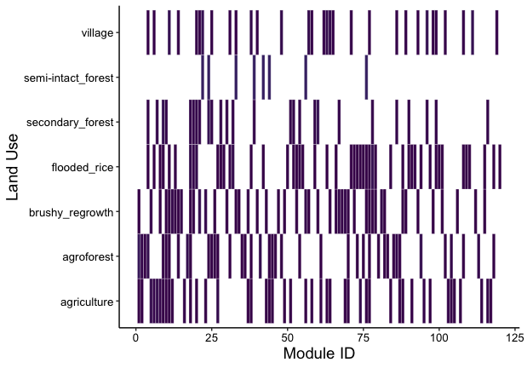
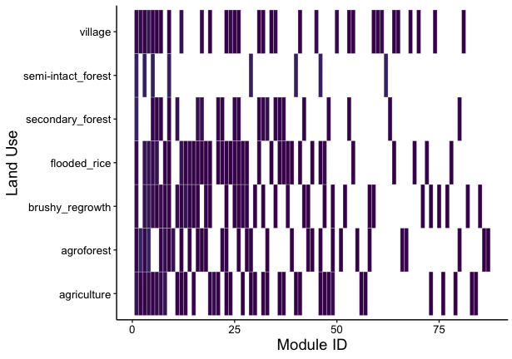
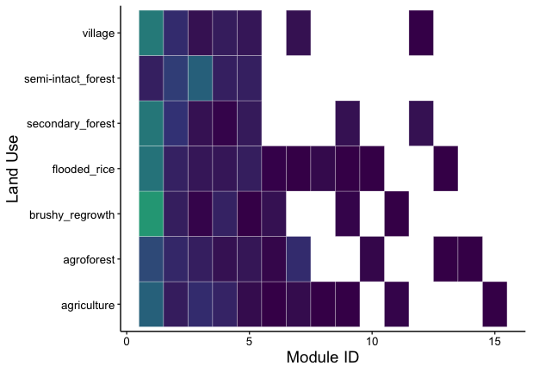
Community detection - Infomap
Rare
Middle
Core

Slide 15
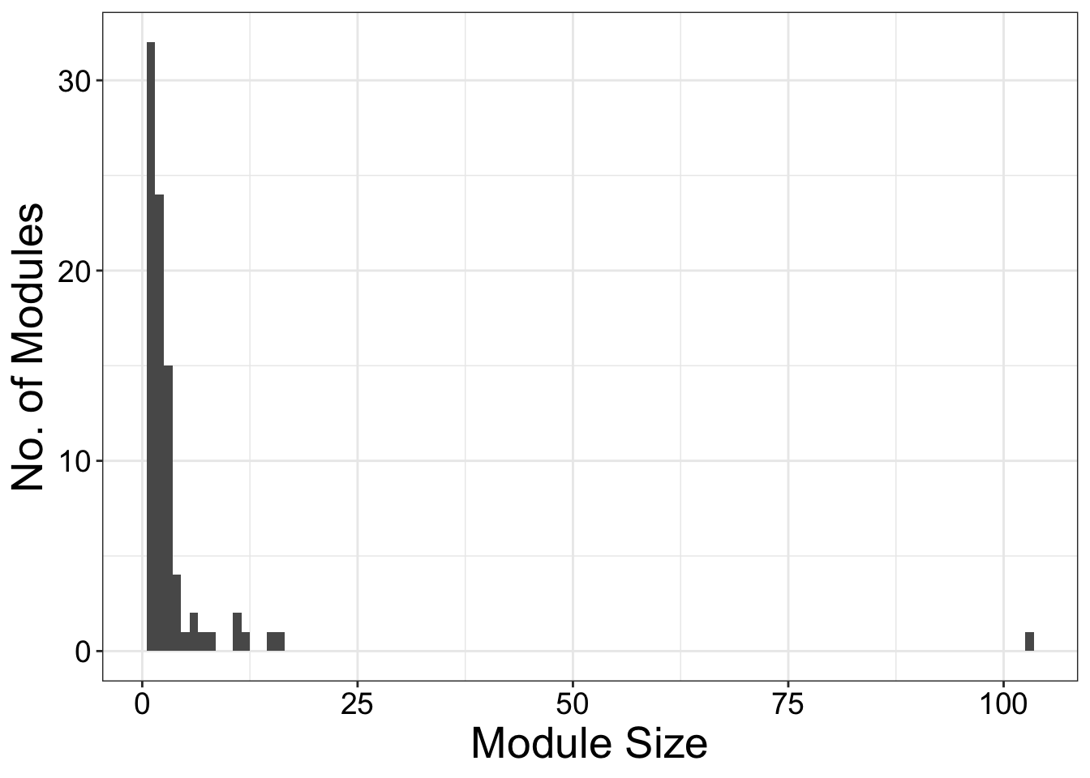
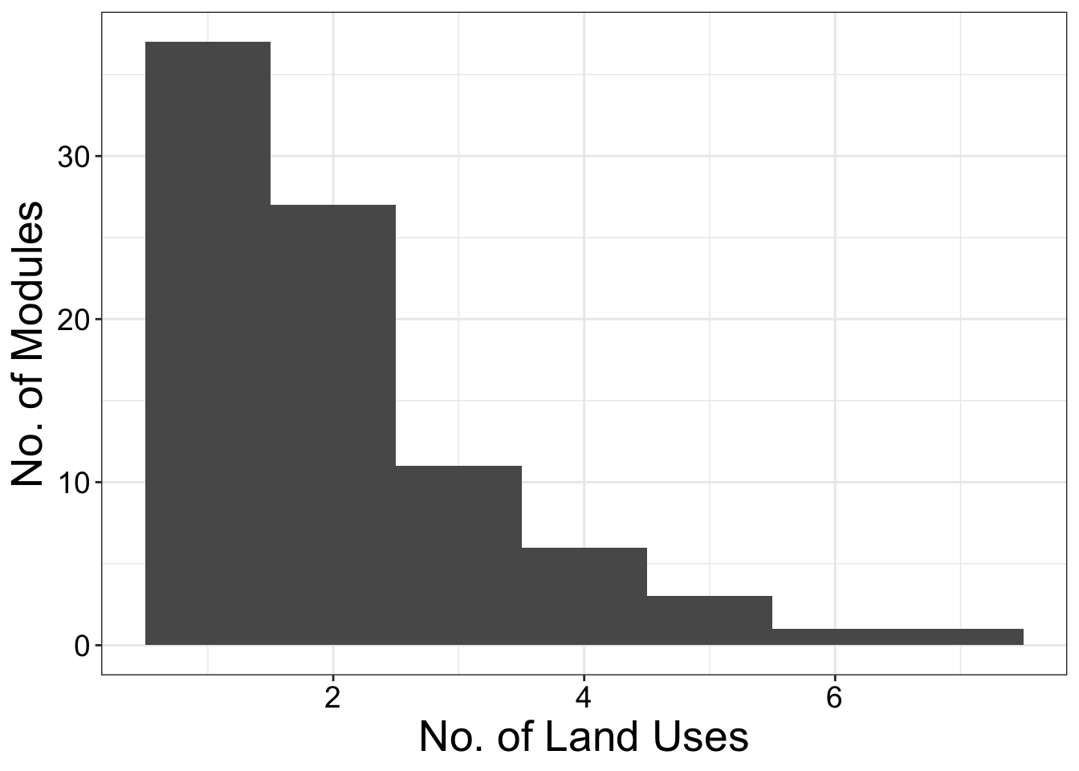
A few big modules encompass hosts from multiple land uses while many small modules encompass hosts from only one or two land uses
86 groups
Notes:
I found that a few big modules encompass rats from multiple land uses while many small modules encompass rats from only one or two land uses. Also, each land use consists of multiple different modules.

Slide 16
What does this modular structure tell us about the processes that shaped the network?
Beta-NTI (Nearest Taxon Index)
Measures phylogenetic turnover compared to the turnover expected by chance
Raup-Crick
Measures turnover compared to the turnover expected by chance
Stegen et. al., 2012; Zhou & Ning, 2017
Notes:
To answer my question we need first to connect between the structure and the processes.

Slide 17
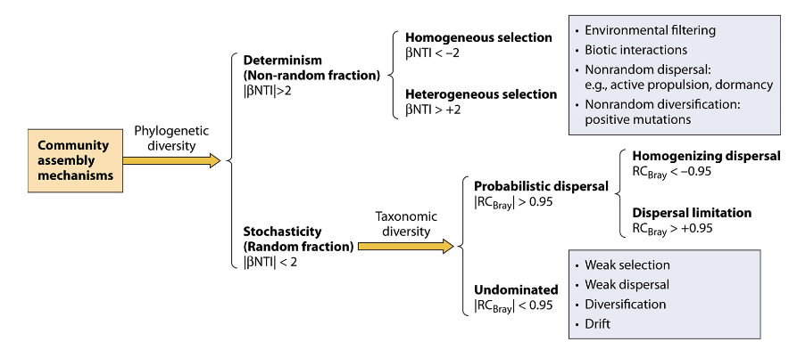
What does this modular structure tell us about the processes that shaped the network?
Stegen et. al., 2012; Zhou & Ning, 2017
Notes:
To answer my question we need first to connect between the structure and the processes.

Slide 18
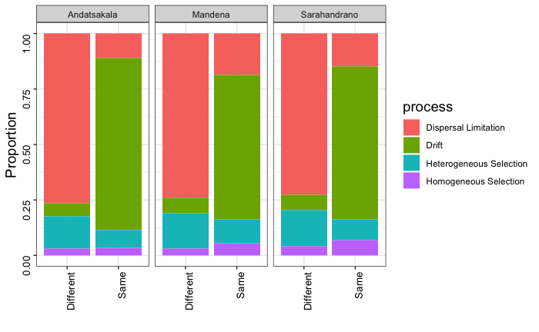
Network’s modules are indicative of the processes
Rare
The modules capture microbe turnover due to dispersal limitation between hosts
Neutral processes dominate the variation between hosts clustered in the same module

Slide 19
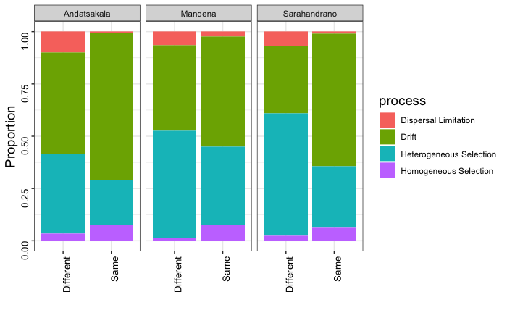
Network’s modules are indicative of the processes
Middle
The modules capture selective differences between hosts
Neutral processes dominate the variation between hosts clustered in the same module

Slide 20
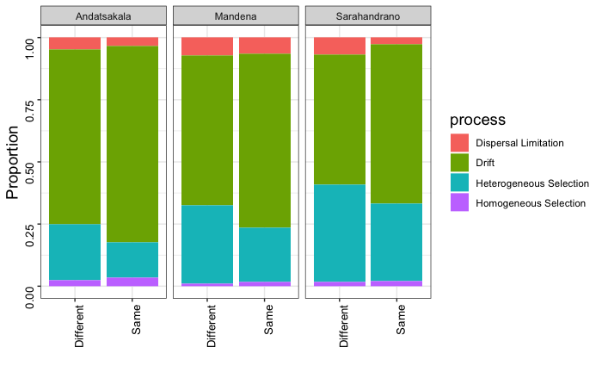
Network’s modules are indicative of the processes
Core
Neutral processes dominate the variation between hosts clustered in same and different modules

Slide 21
Q1. What are the processes shaping the structure of host-microbe communities along a land use change gradient?

Slide 22
Normalized Mutual Information (NMI)
NMI = 1
NMI = 0
 | LU1 | LU2 | LU3 | LU4 | LU5
Group 1 | 10
Group 2 |  | 10
Group 3 |  |  | 10
Group 4 |  |  |  | 10
Group 5 |  |  |  |  | 10
H1
 | LU1 | LU2 | LU3 | LU4 | LU5
Group 1 | 50
 | LU1 | LU2 | LU3 | LU4 | LU5
Group 1 | 2 | 2 | 2 | 2 | 2
Group 2 | 2 | 2 | 2 | 2 | 2
Group 3 | 2 | 2 | 2 | 2 | 2
Group 4 | 2 | 2 | 2 | 2 | 2
Group 5 | 2 | 2 | 2 | 2 | 2
H2
H3
Taya et. al., 2016
Notes:
to measure the degree of agreement between the hosts' land use and the hosts' modules.

Slide 23
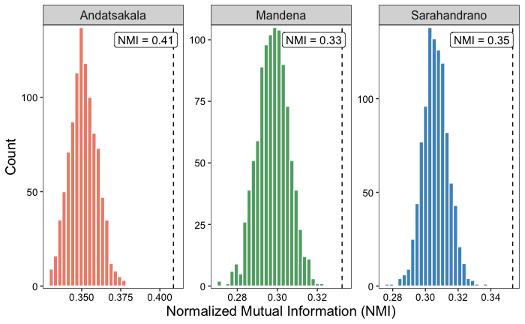
Rare

Slide 24
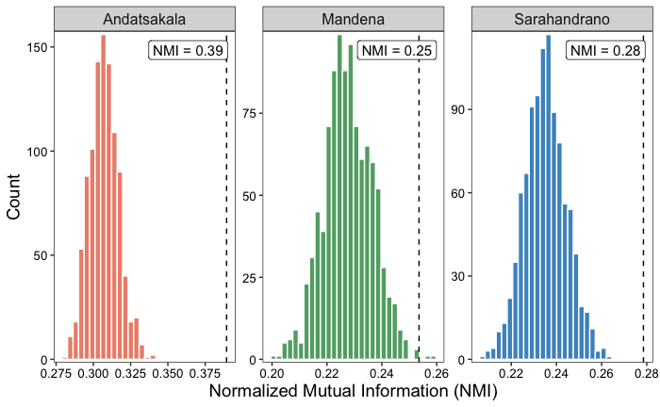
Middle

Slide 25
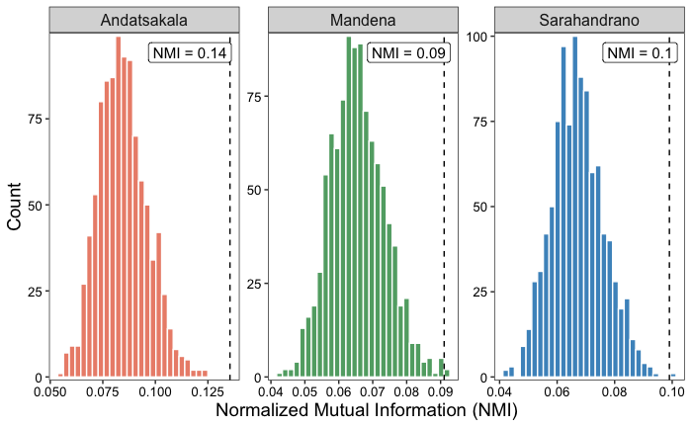
Core

Slide 26
The landscape is continuous
Land use change alters the environment heterogeneity
Q1.2. How does the composition of modules vary across land uses change gradient?
H2 + H3

Slide 27
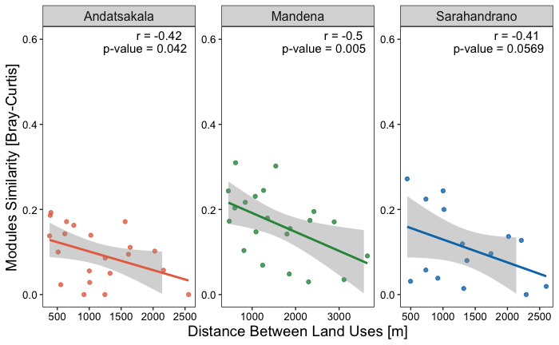
Rare Land uses farther apart show lower similarity in modules

Slide 28
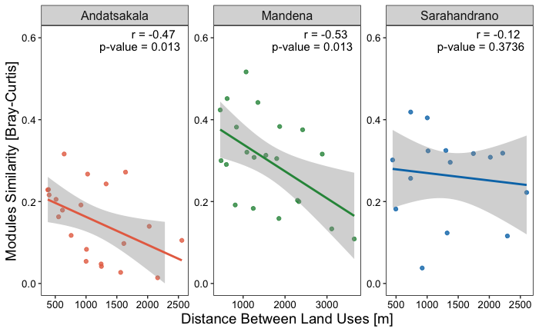
Middle Land uses farther apart show lower similarity in modules

Slide 29
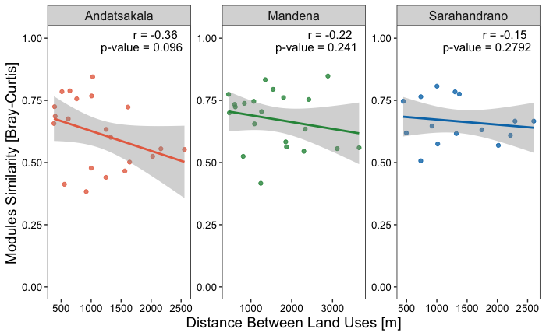
Core Land uses farther apart don’t show lower similarity in modules

Slide 30
Q3. Can we predict links in the network?
Q3.1. What are the important features in the prediction?
Random forest
Features: degree, hosts’ variables, land use variables

Slide 31
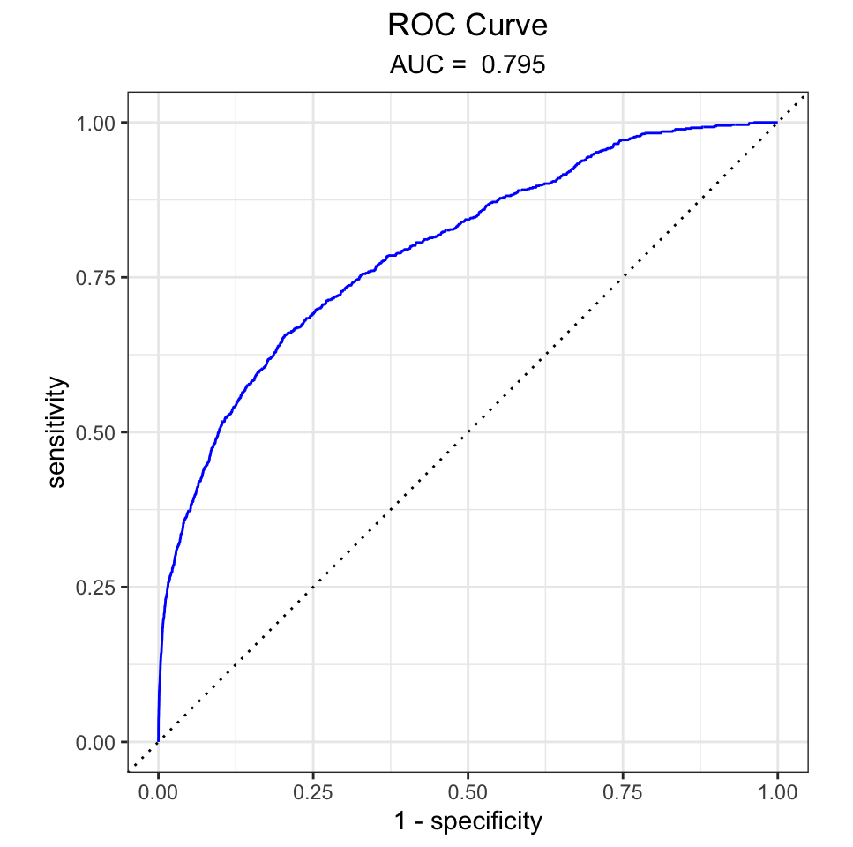
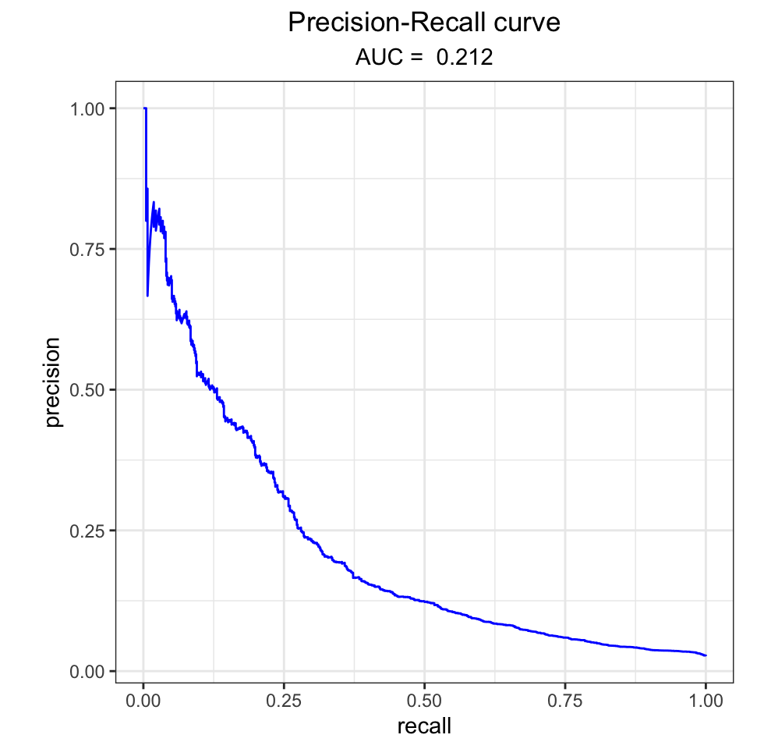
Link prediction
Accuracy = 0.974
Precision = 0.661
Recall = 0.055
F1 = 0.102

Slide 32
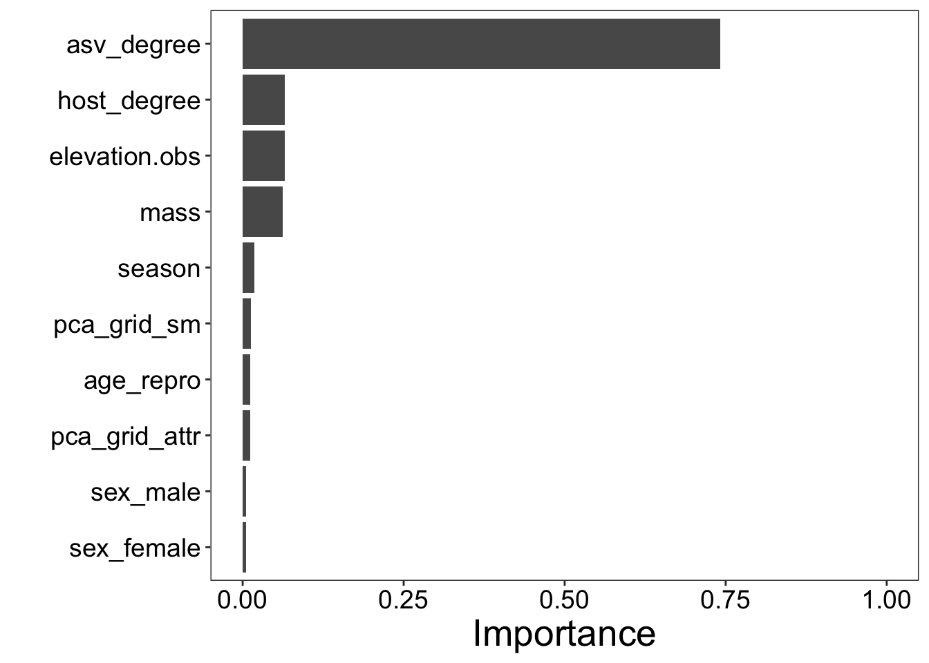
Link prediction – Features importance

Slide 33
Summary
A combination of neutral and selective processes shape the host microbiome
The system is mostly neutral (stochastic)
Land use change alters the environment heterogeneity and induces gradual selective pressures
The selective impact within and across land use is driven by rare microbes that clustered in small modules associated to specific land uses

Slide 34
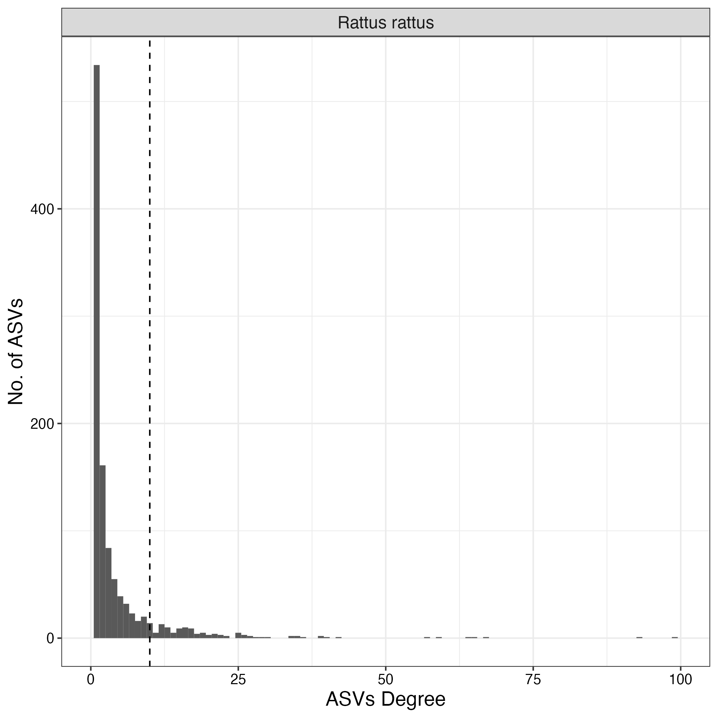
Degree distribution
Connectance:
Rattus = 1.5%
Most ASVs occur in less than 10 hosts

Slide 35
Land use change
Human-Wildlife interface
Host community change
Vegetation change
Environment species pool
Diet shift
Host dispersal
Host Microbiome

Slide 36
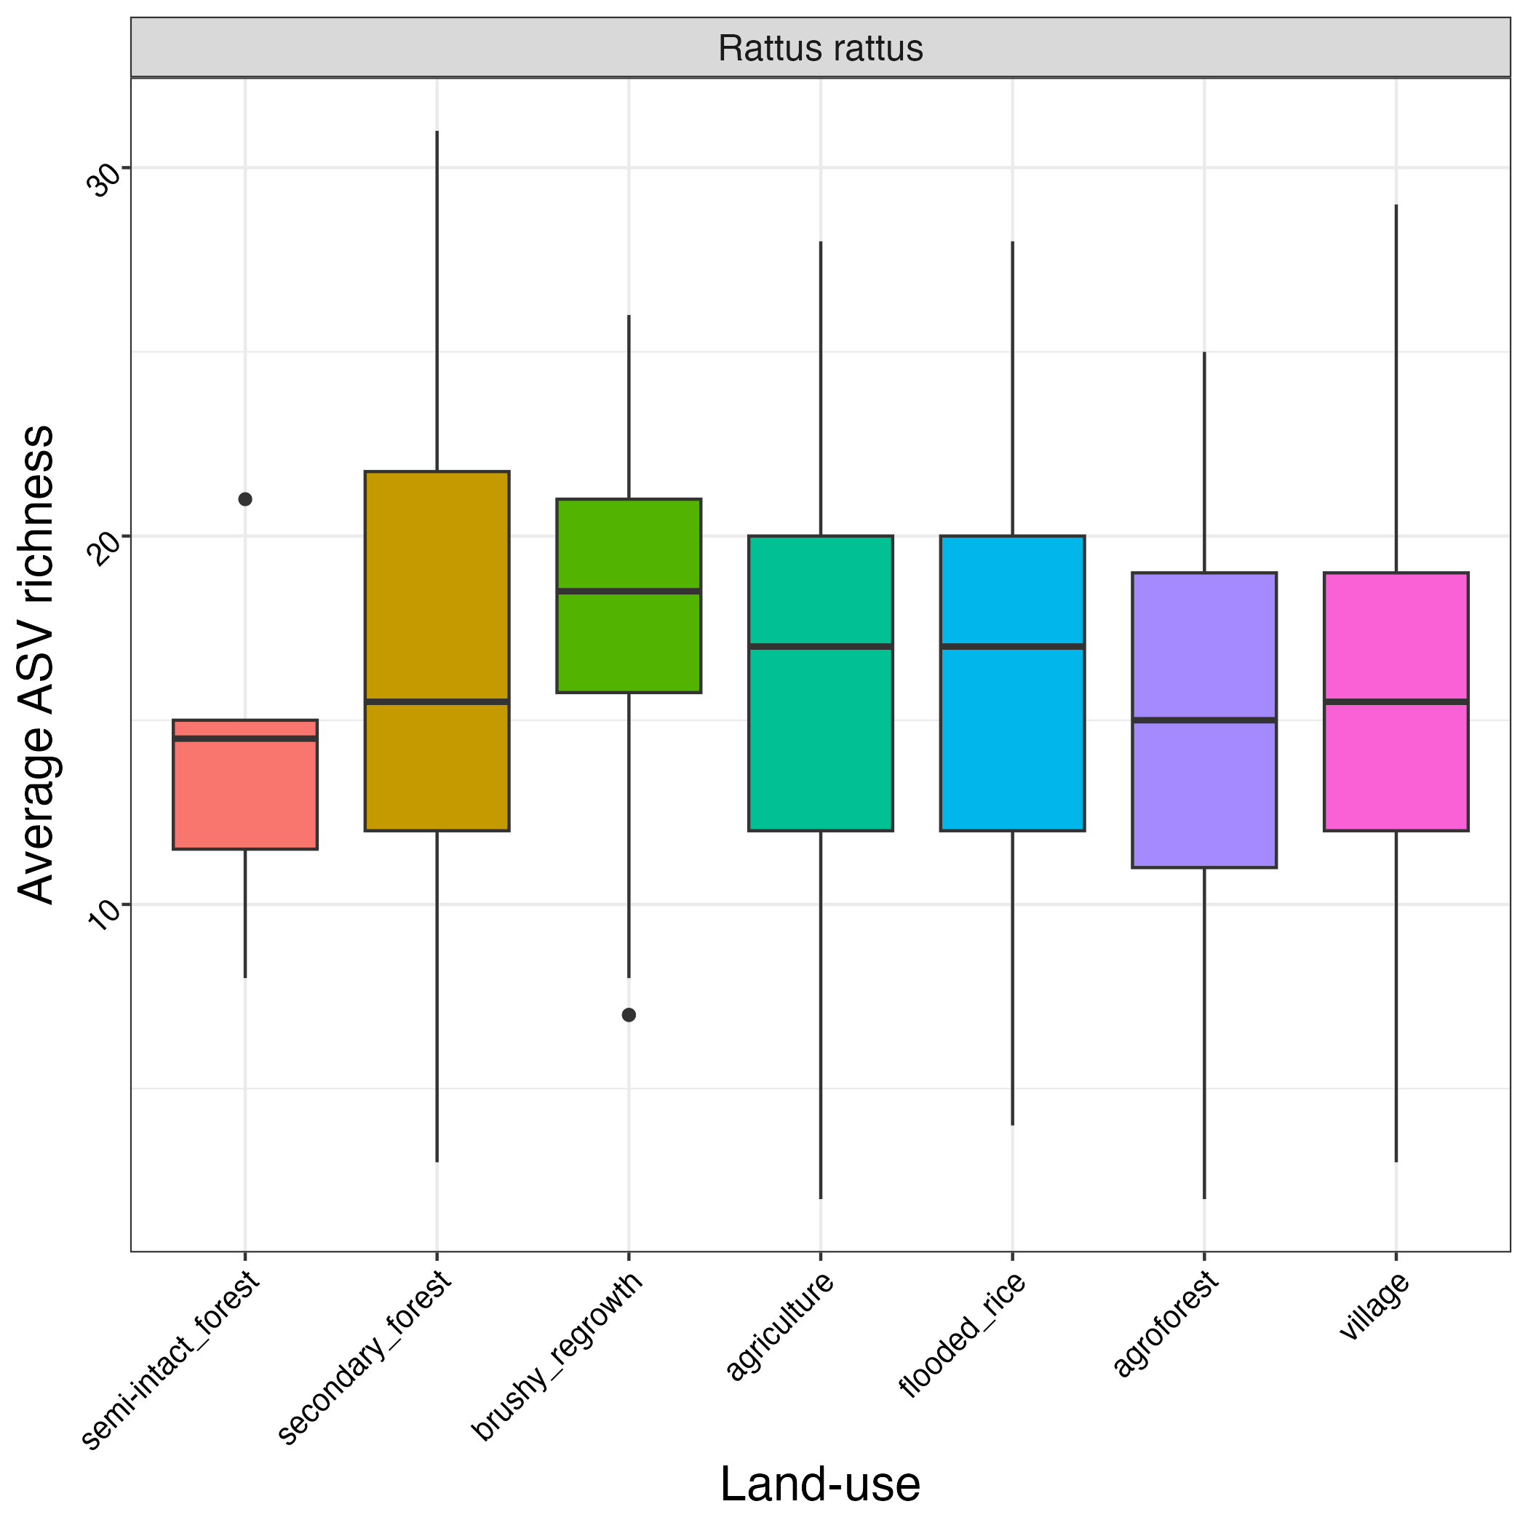
ASVs richness is not changed across land use

Slide 37
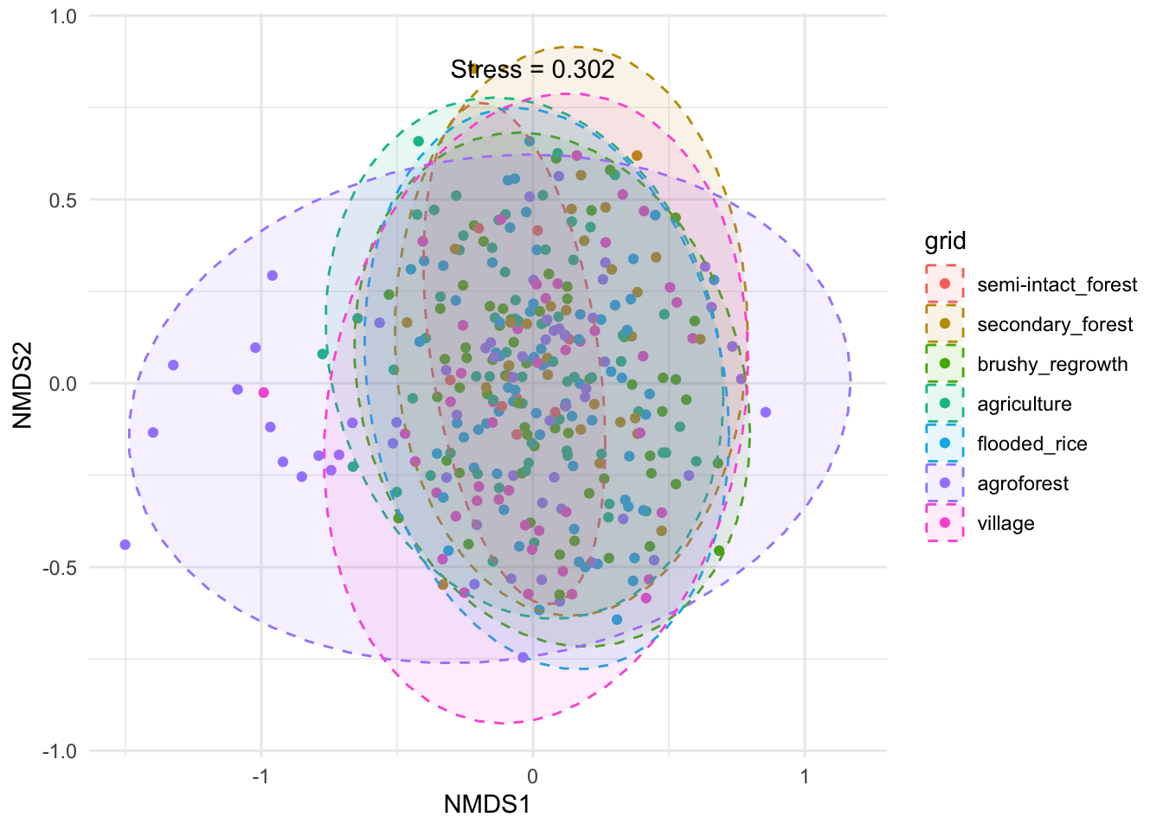
High inter-individual microbiome variation
Beta-diversity [Jaccard] = 0.05
F = 1.23, p < 0.01

Slide 38
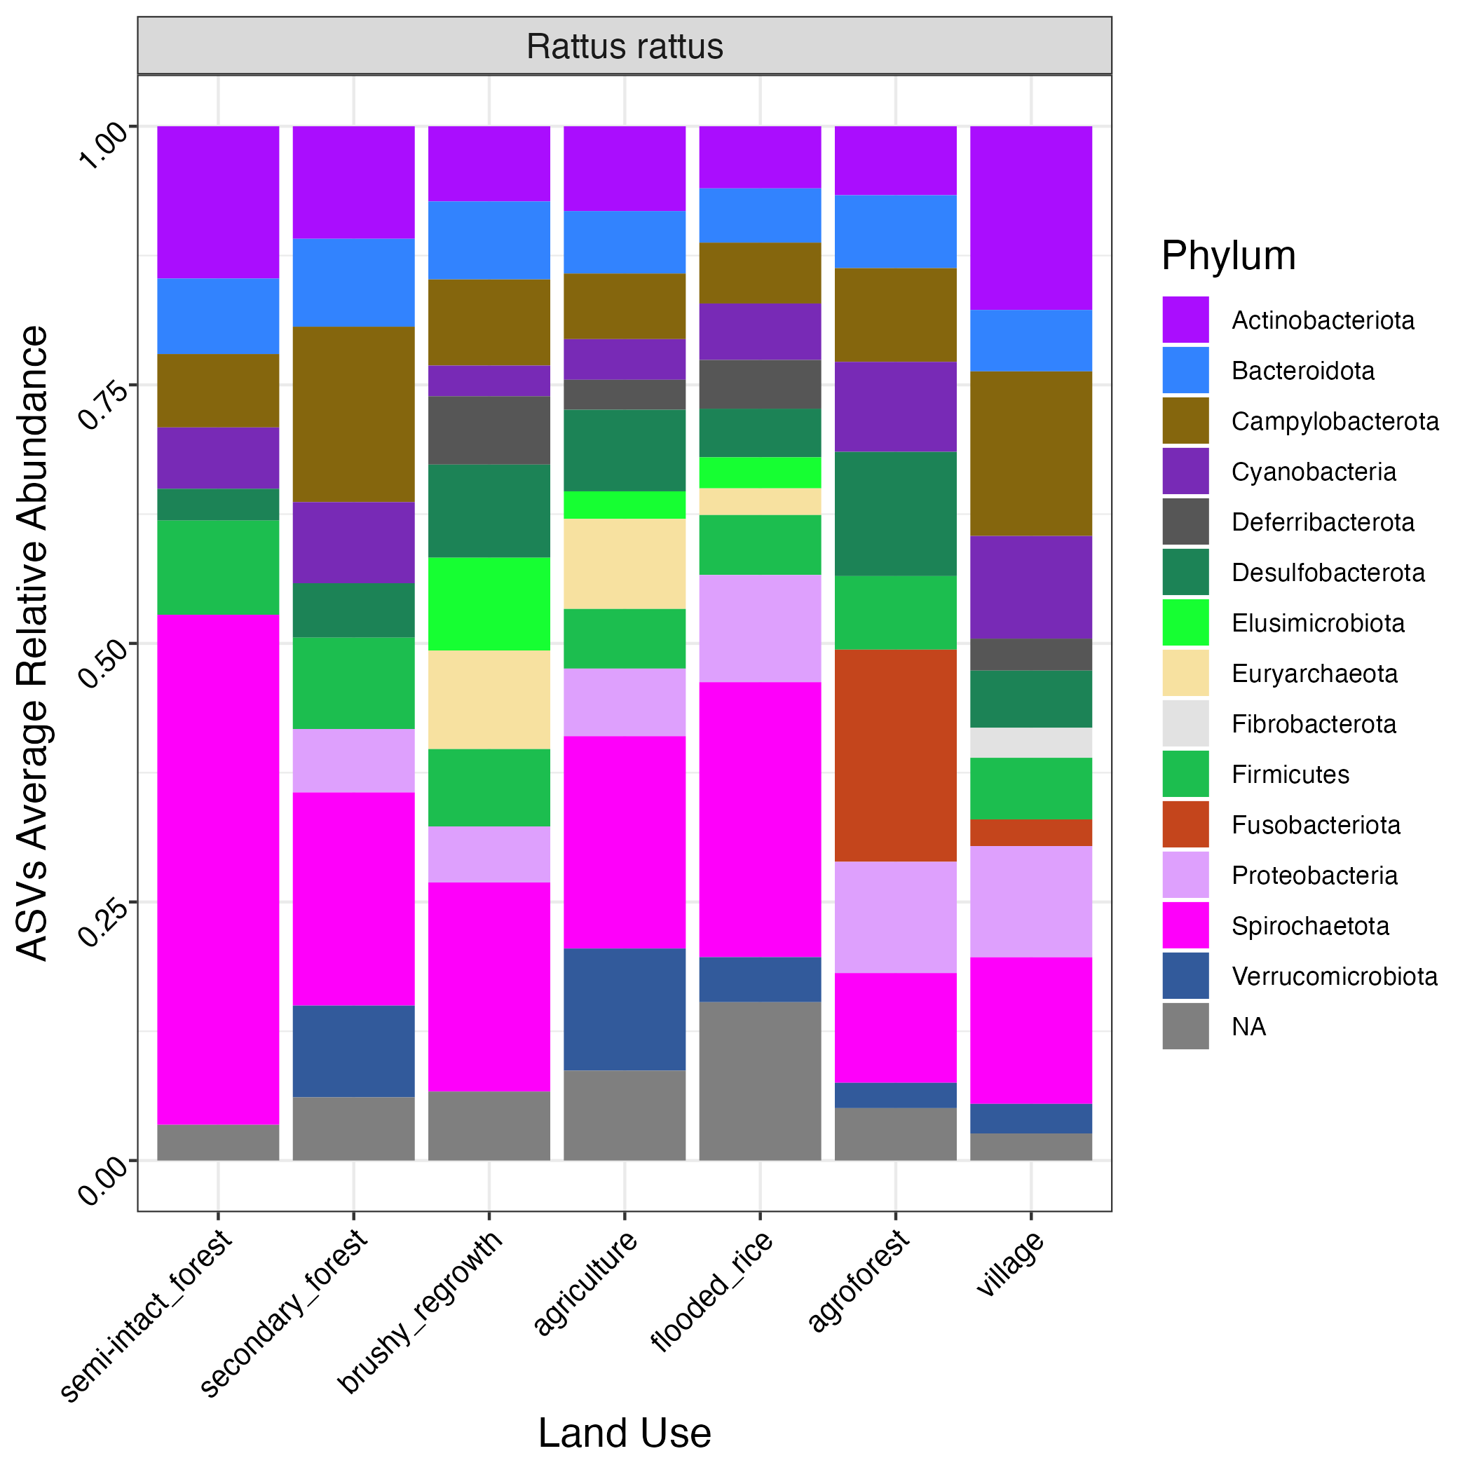
ASVs taxonomy

